Slide 1
Portfolio Metrics overview

Slide 2
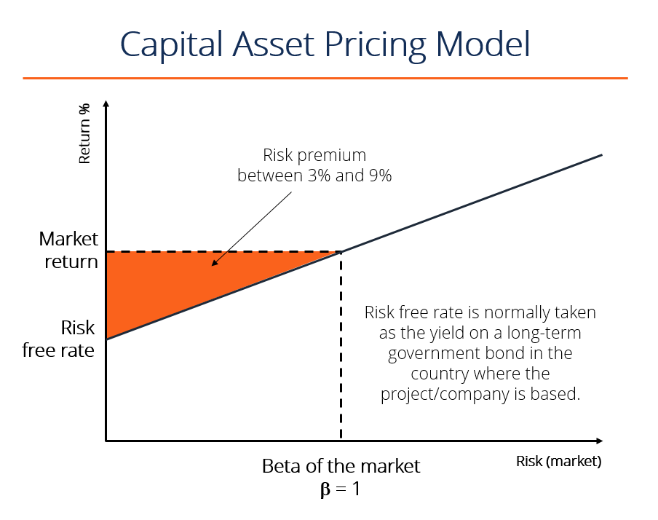
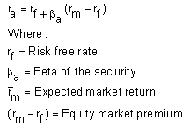
CAPM Model
The CAPM equation is used to identify the required return of an investment based on level or risk
Basically conveys there’s a proportional amount of risk you need to take on to achieve a certain return for an asset/portfolio
Formula:

Slide 3
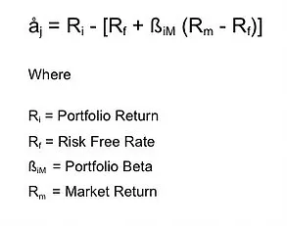
Alpha
Excess return on an investment relative to the return on a benchmark index
Mathematically it is the rate of return that exceeds what was expected or predicted by the CAPM model
When you hear, “I beat the market” from a fund manager this is typically the metric they will cite

Slide 4

Beta
Measure of risk (volatility) in comparison to the overall market
Market always has a beta of 1
If the asset/portfolio has a beta of 1.12, than it’s theoretically .12x riskier than the market. Vice versa for a beta below 1.
Beta is a coefficient of the CAPM (Capital Asset Pricing Model) which can be calculated as:
Where:
Ra = Excess returns of asset
Rb = Excess returns of market

Slide 5
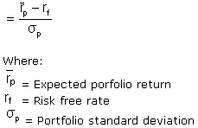
Sharpe ratio
What is it and why is it important?
The ratio describes how much excess return you are receiving for the extra volatility that you endure for holding a riskier asset
The higher the Sharpe ratio, the better a fund’s return relative to the risk it’s taken on
The idea is that you need to be compensated for the additional risk you take on by not investing in the risk free asset
Widely used as measure of fund performance with asset managers
Formula:

